Slide 1
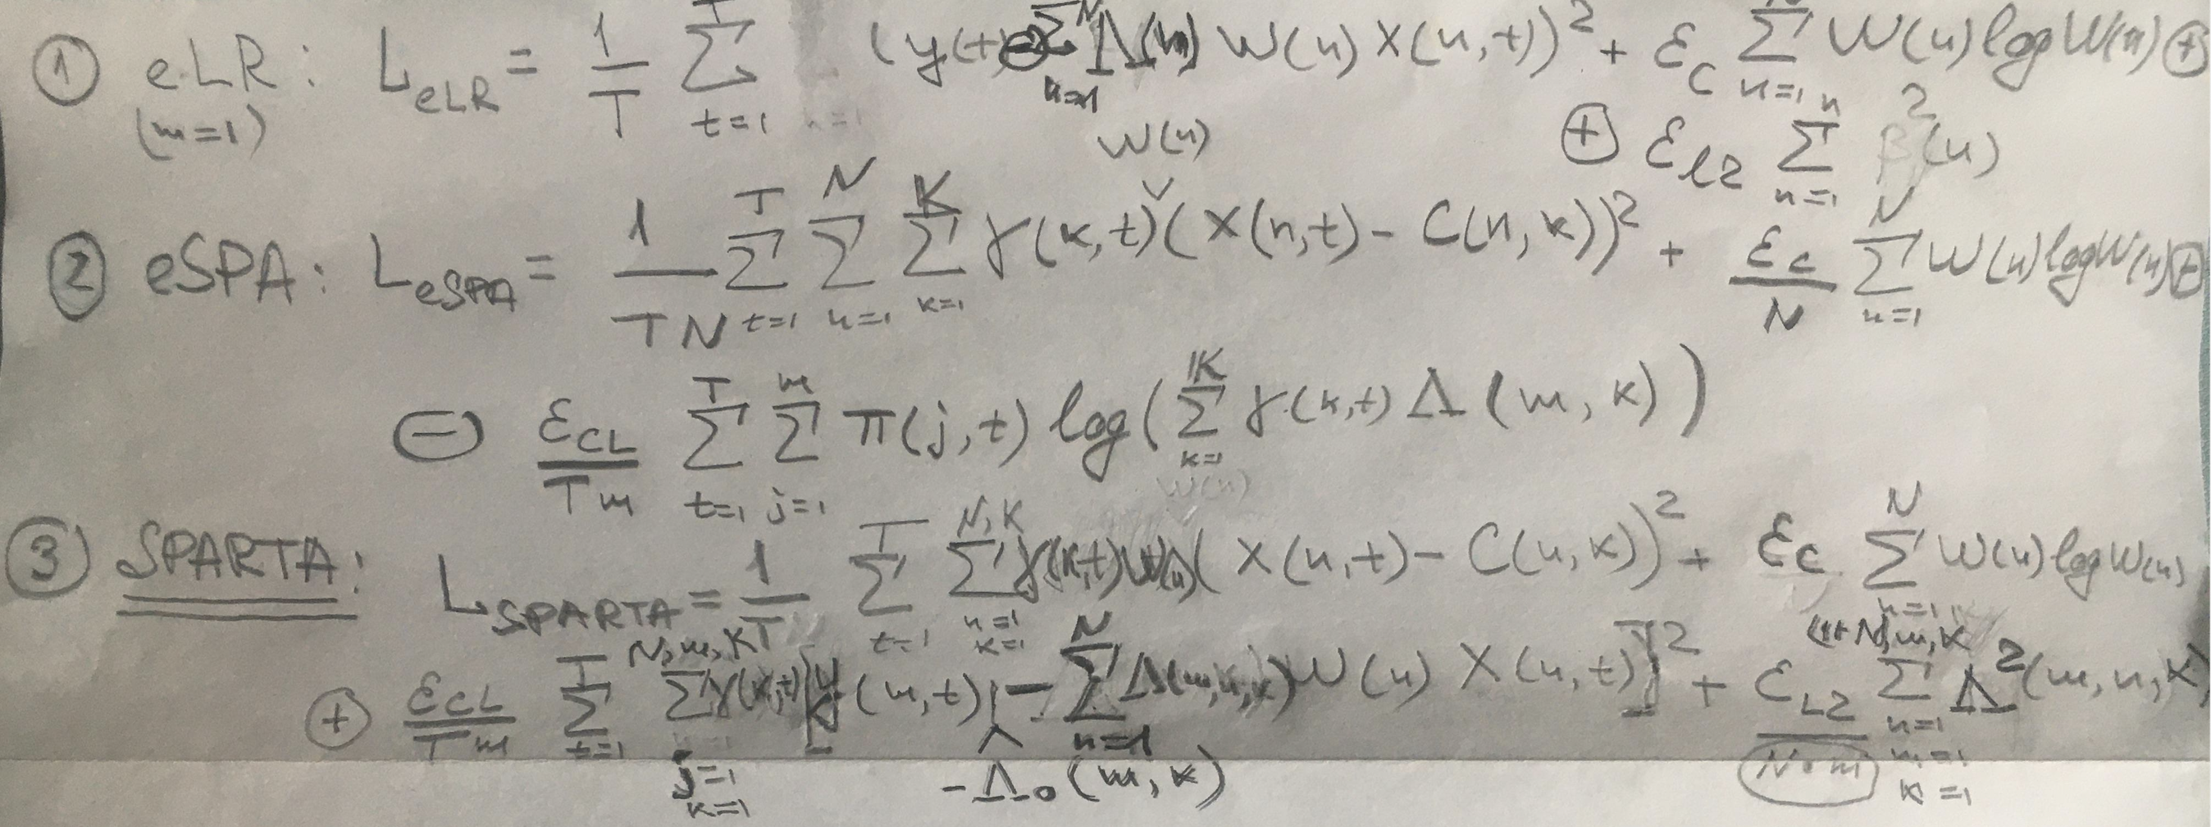
From eSPA to entropically-sparsified Linear Regression (eLR)
and to Sparse Probabilistic Approximation for Regression Task Analysis (SPARTA)
Mathematical idea behind SPARTA: joint numerically-scalable (linear in T and K, loglinear in N) solution of feature X discretization (first term), entropic feature sparsification (second term) and regularized piecewise-linear regression problems (third and fourth terms)

Slide 2
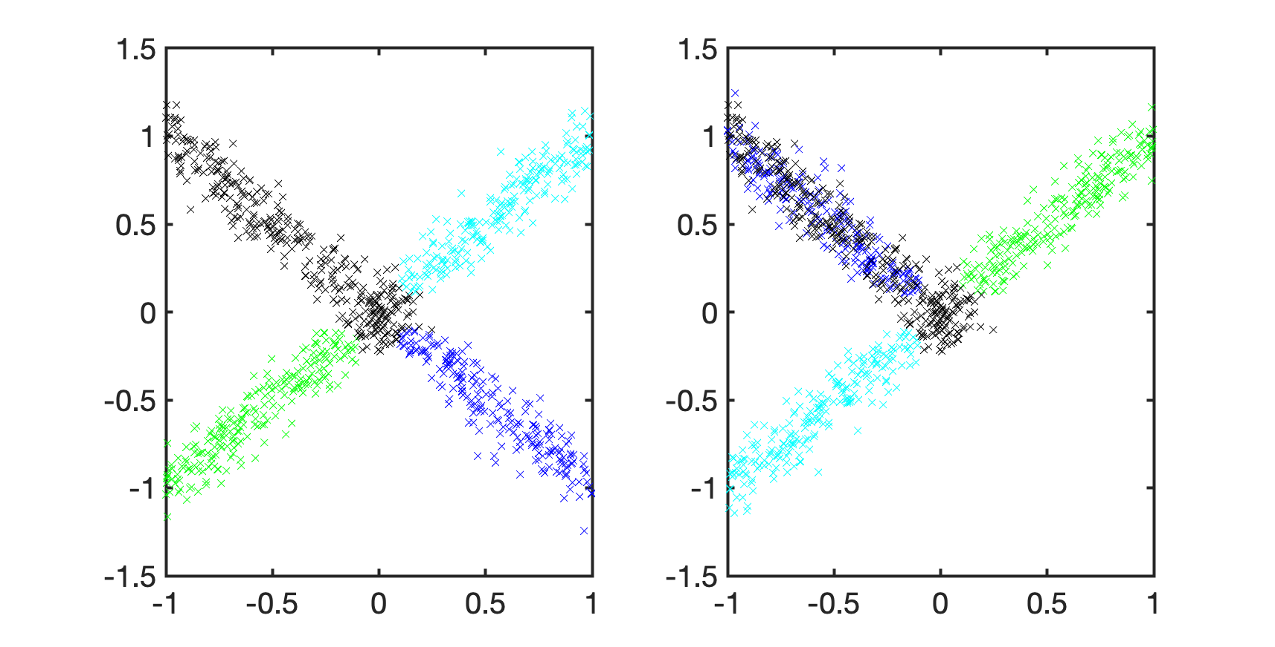
Synthetic example: piecewise-linear transformation f:R^{N}→R² of a 2D image of letter X
(hidden N dimensions without any image information) into a 2D image of letter Y

Slide 3
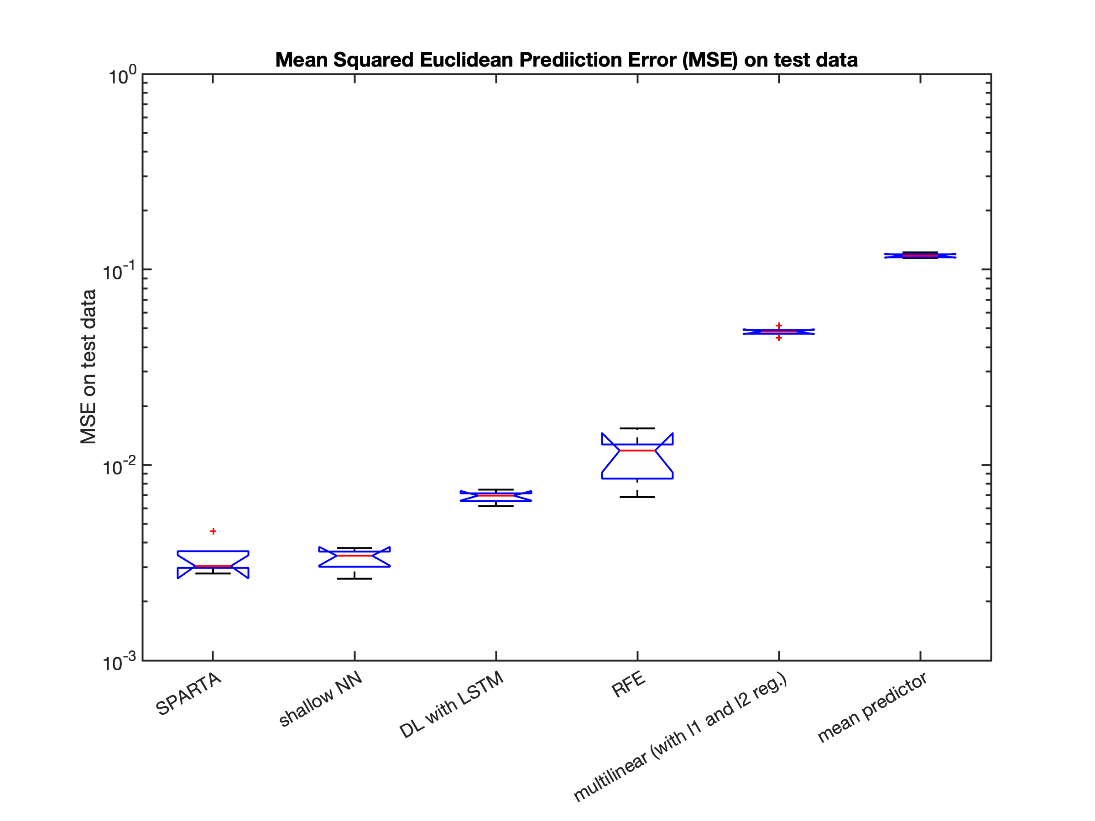
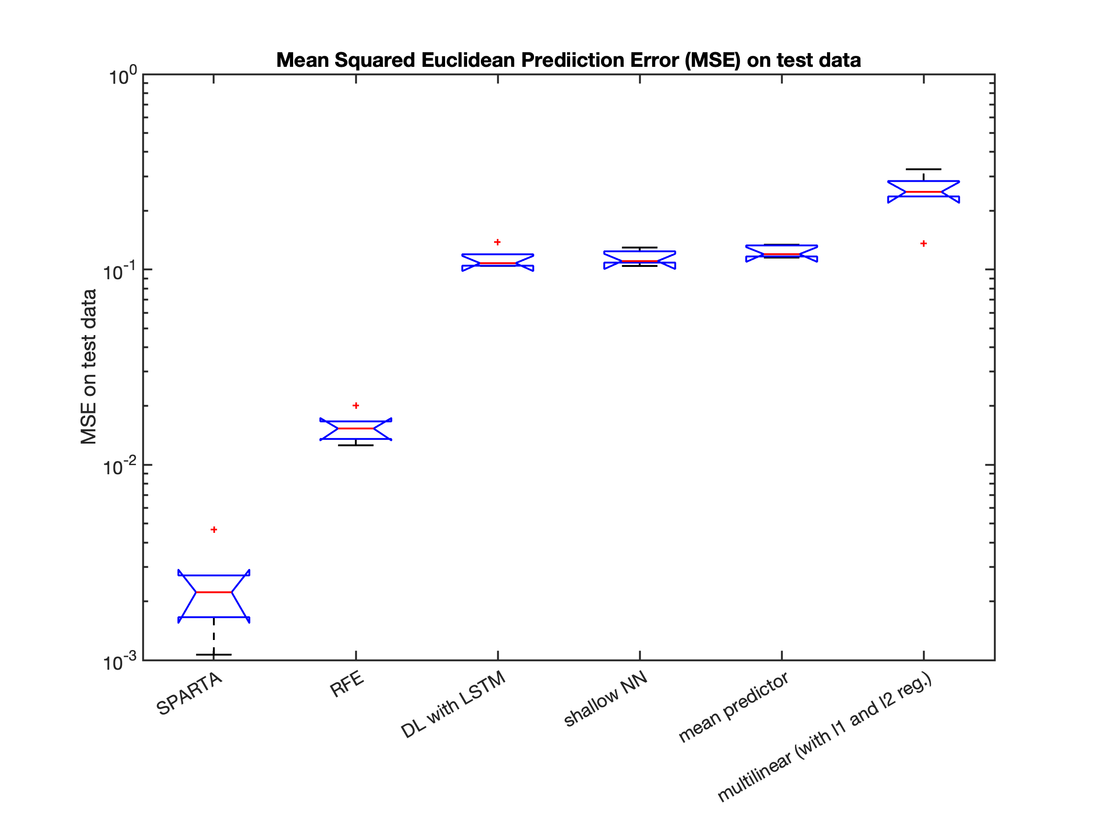
Synthetic example: piecewise-linear transformation f:R^{N}→R² of a 2D image of letter X
(hidden N dimensions without any image information) into a 2D image of letter Y
N=10, T=1000
N=200, T=1000

Slide 4
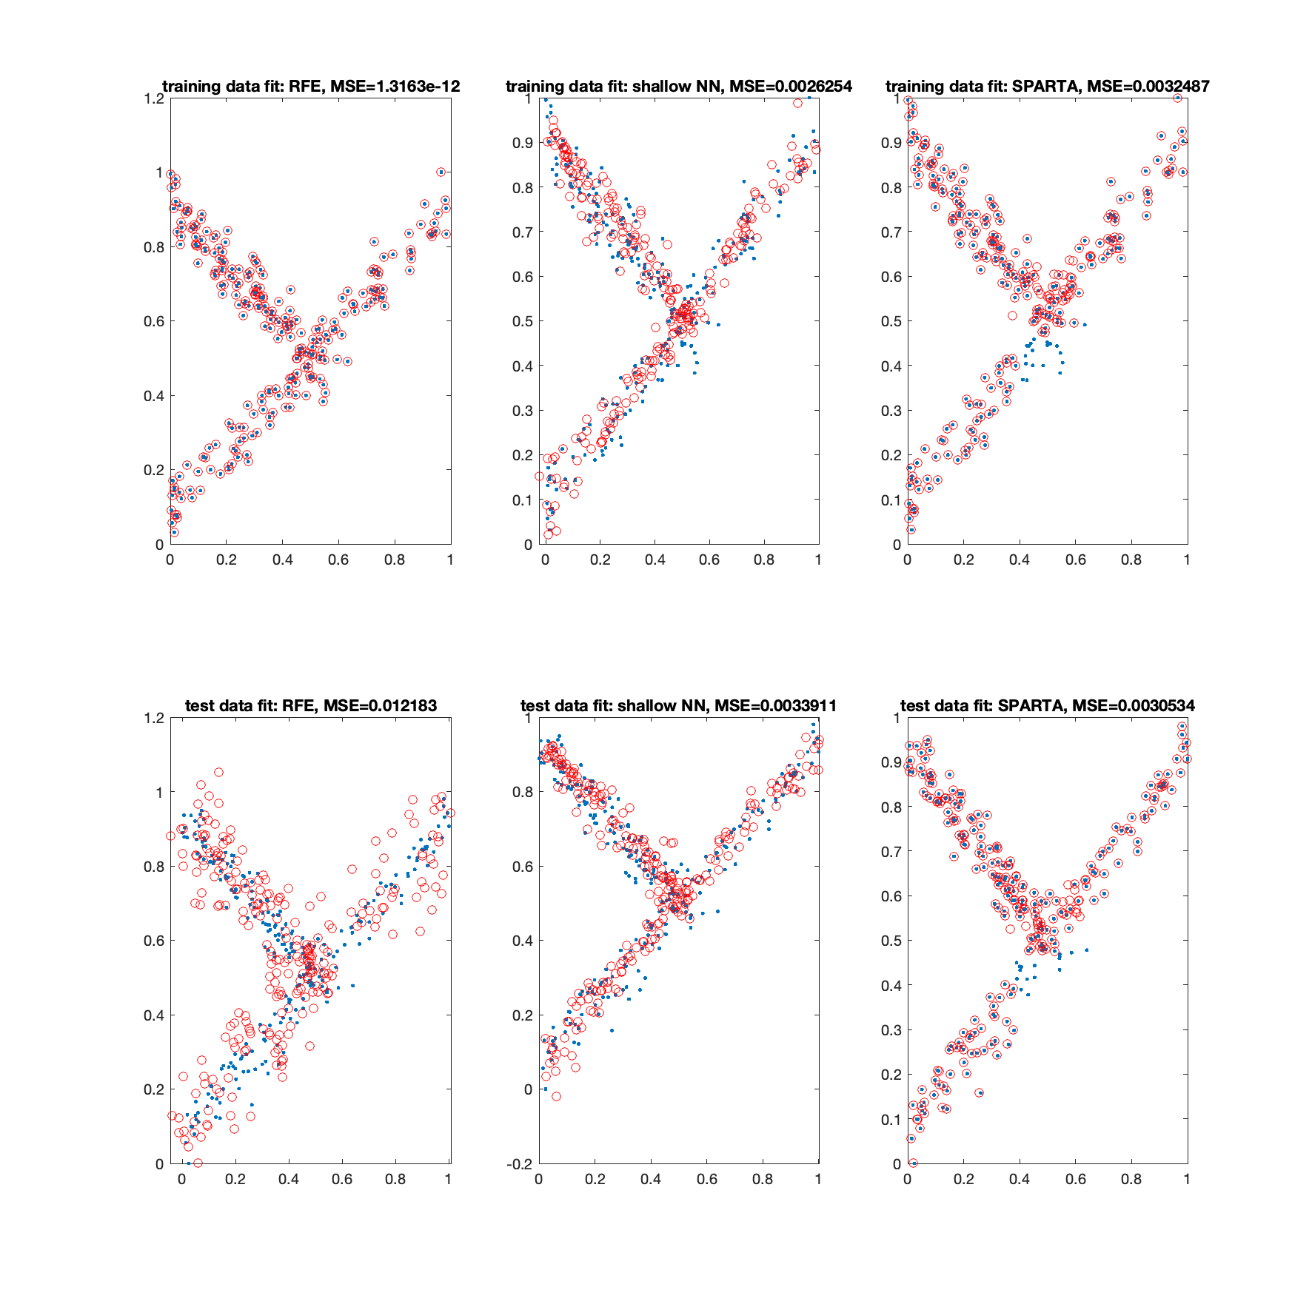
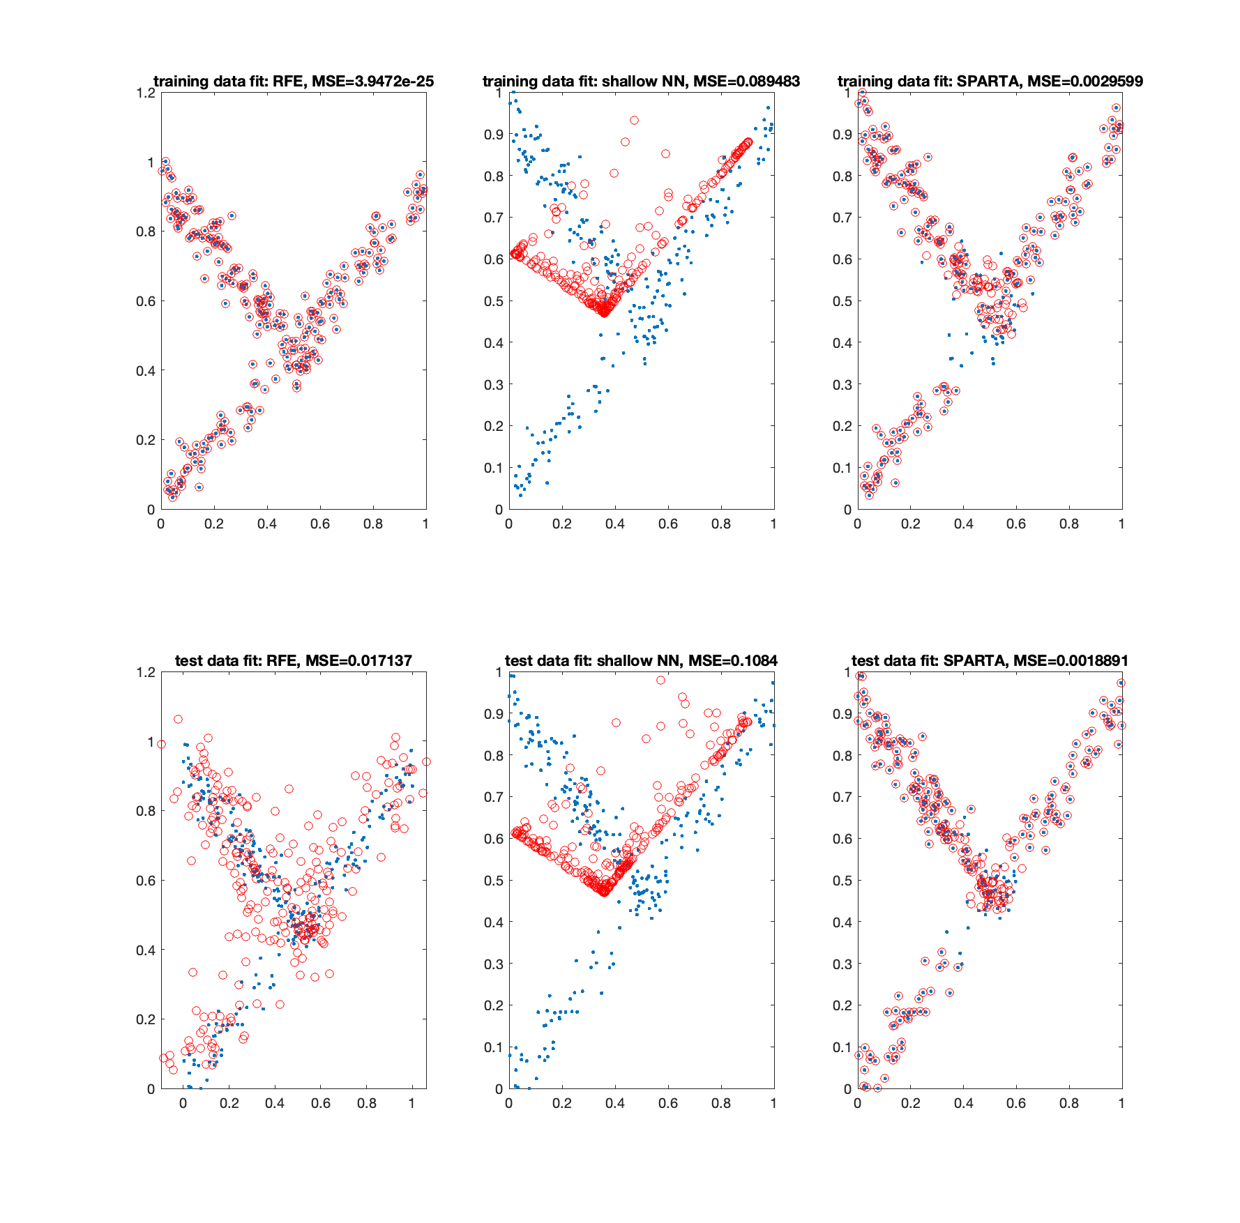
Synthetic example: piecewise-linear transformation f:R^{N}→R² of a 2D image of letter X
(hidden N dimensions without any image information) into a 2D image of letter Y
N=10, T=1000
N=200, T=1000

Slide 5
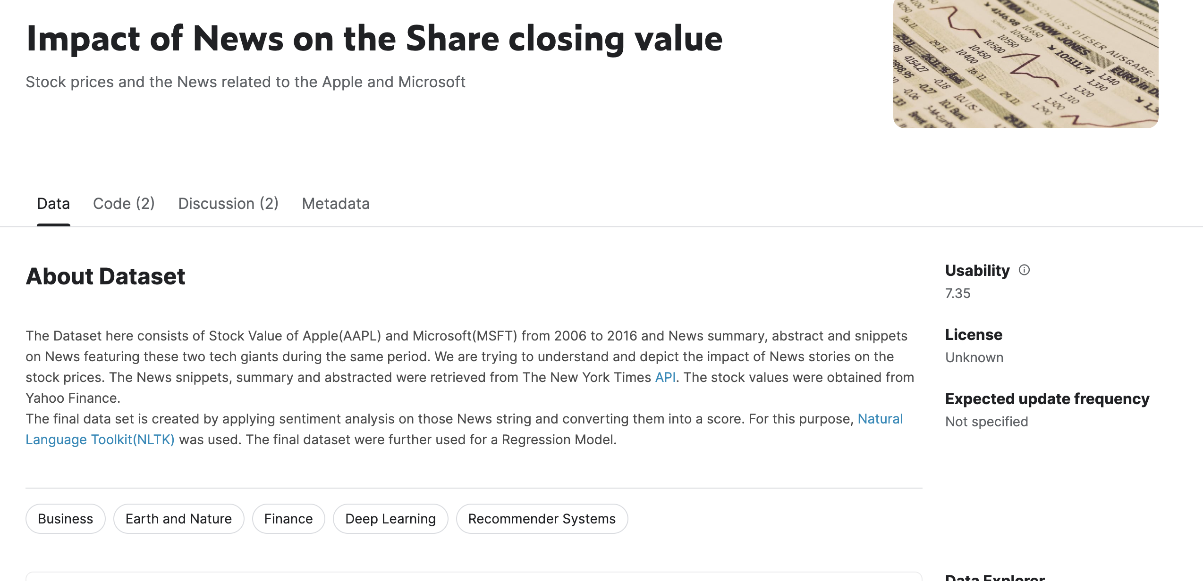
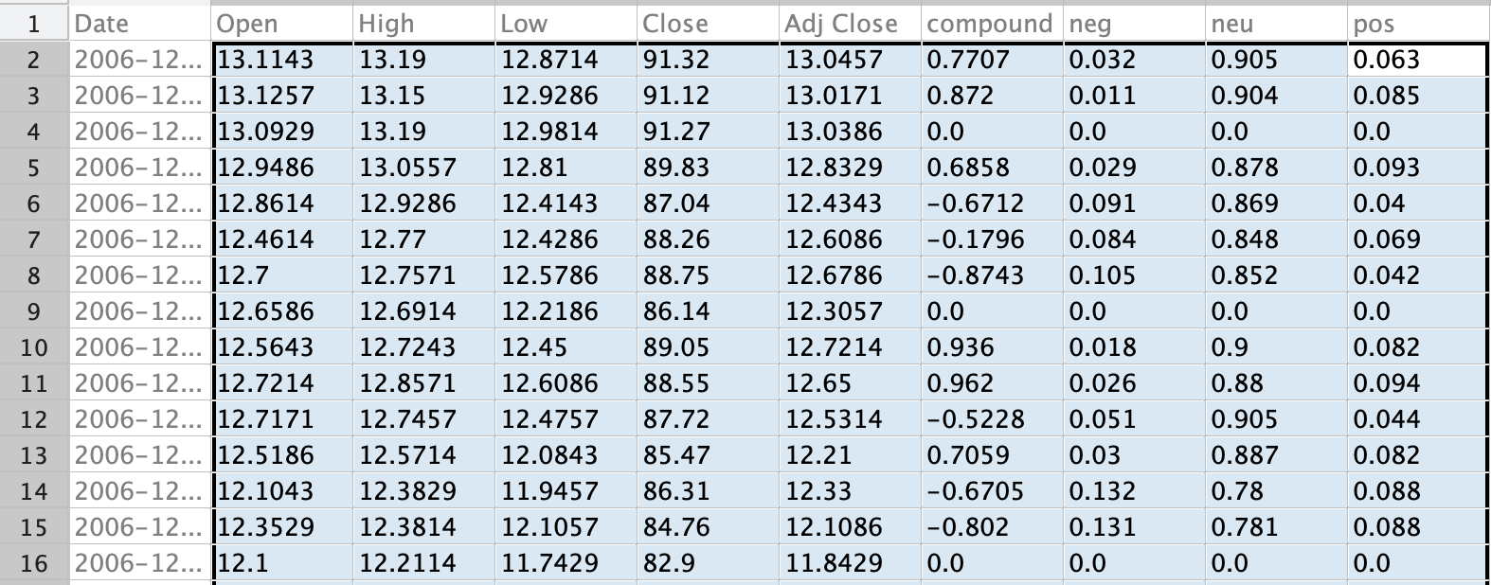
Application example 1: predicting dayly change of price (S_{t+1}-S_{t}) and its dependence
from previous days price changes (open, low, high, close) AND news proportion sentiments (positive, neutral, negative)
for dayly Apple Stock between 2006 and 2016. Data from Kaggle.com.
https://www.kaggle.com/datasets/BidecInnovations/stock-price-and-news-realted-to-it

Slide 6
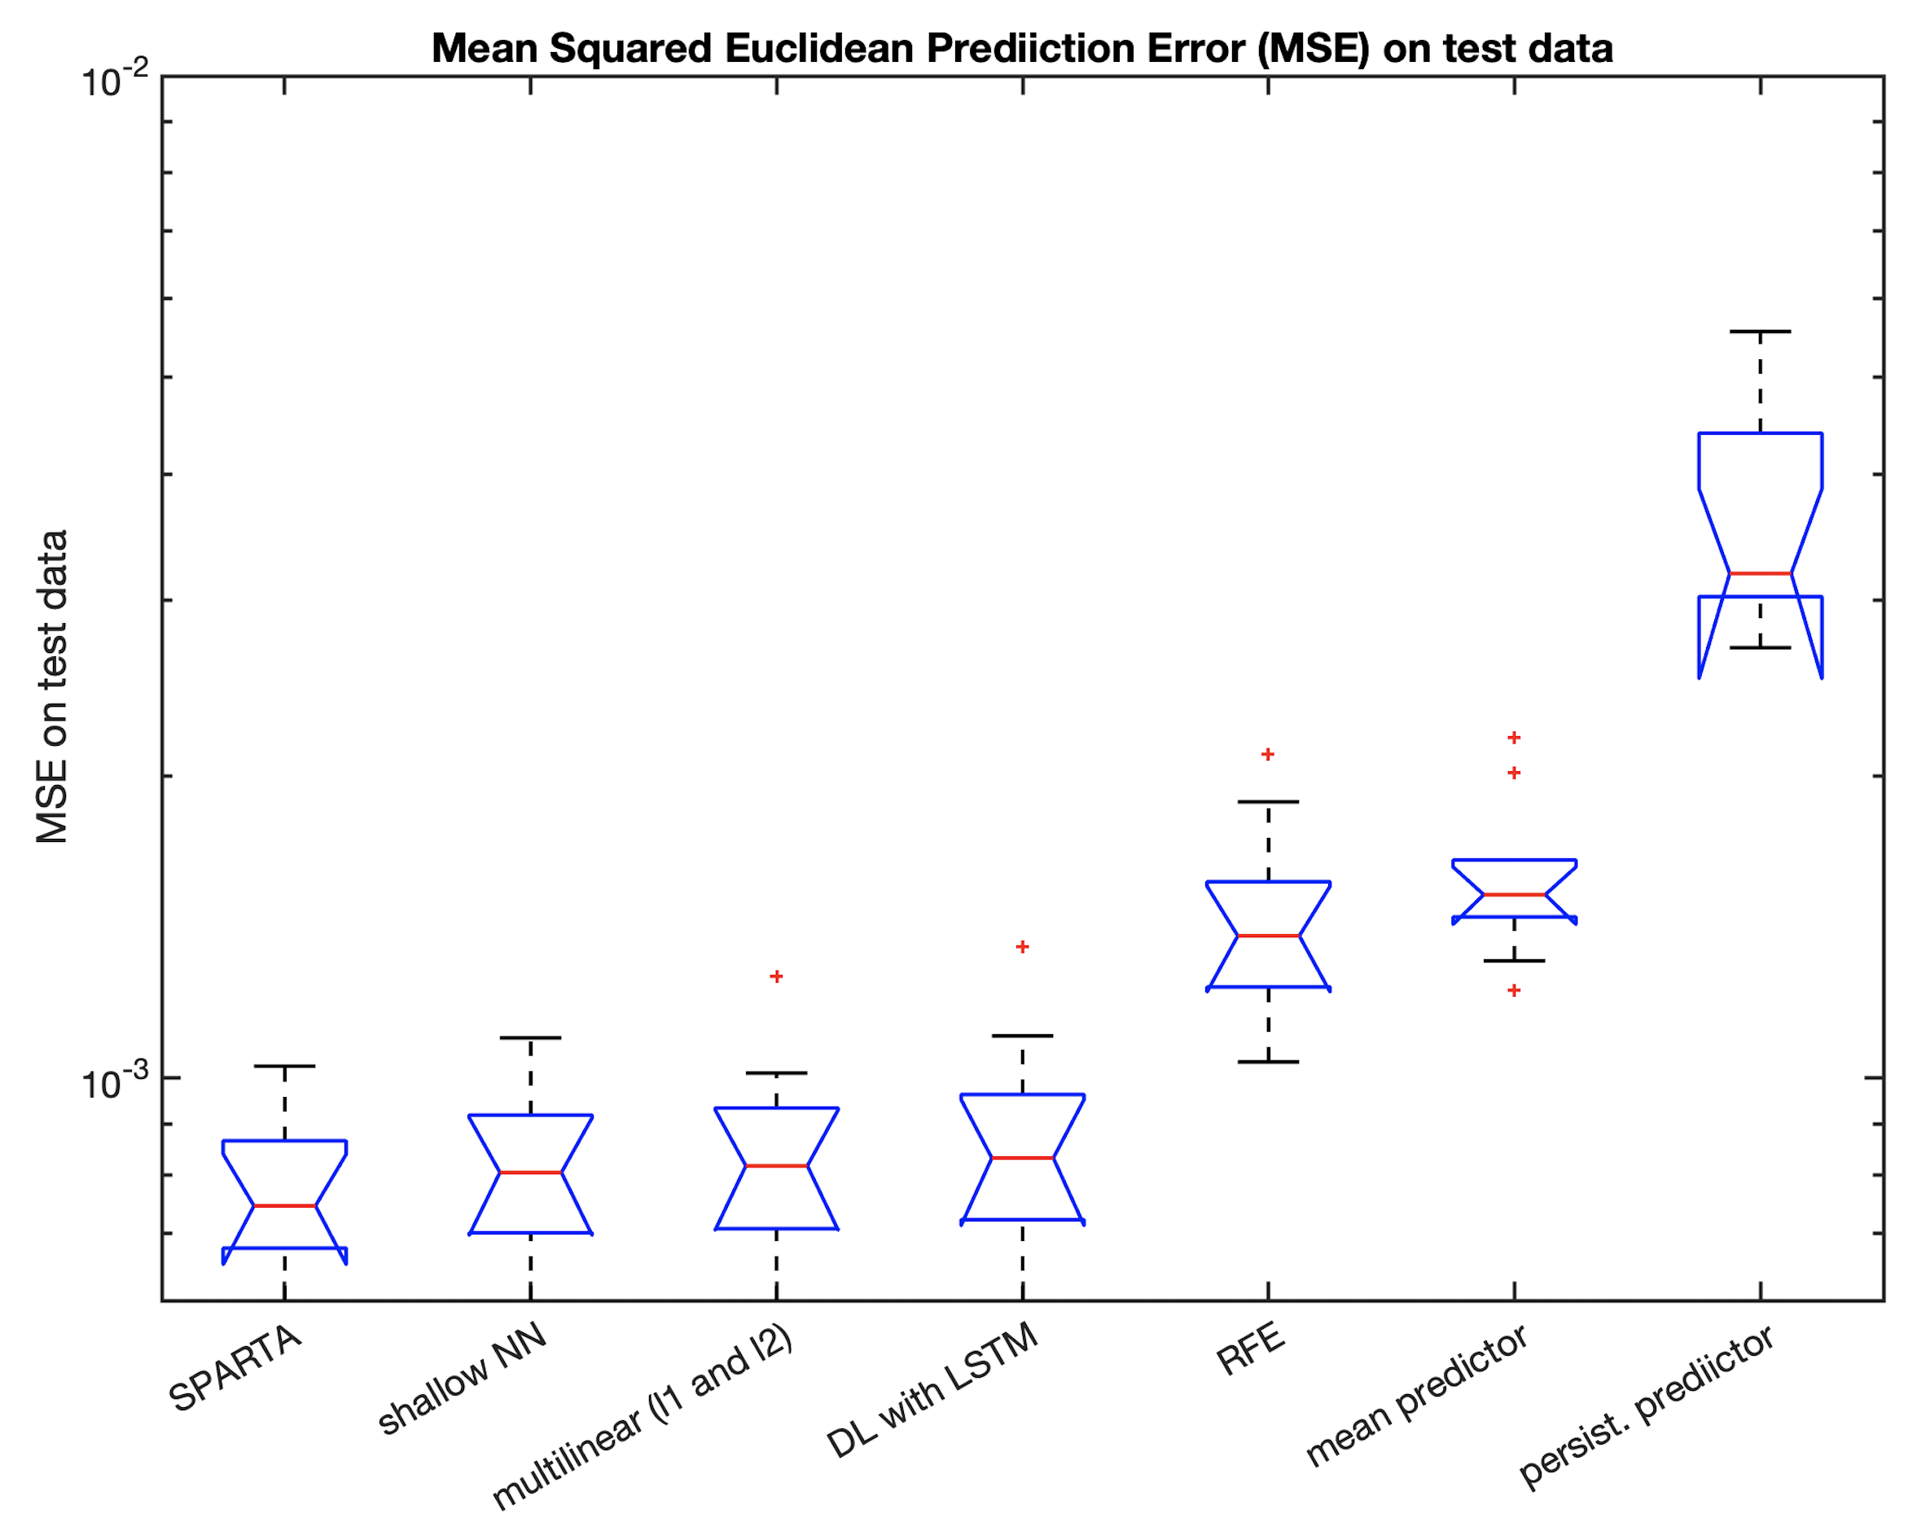
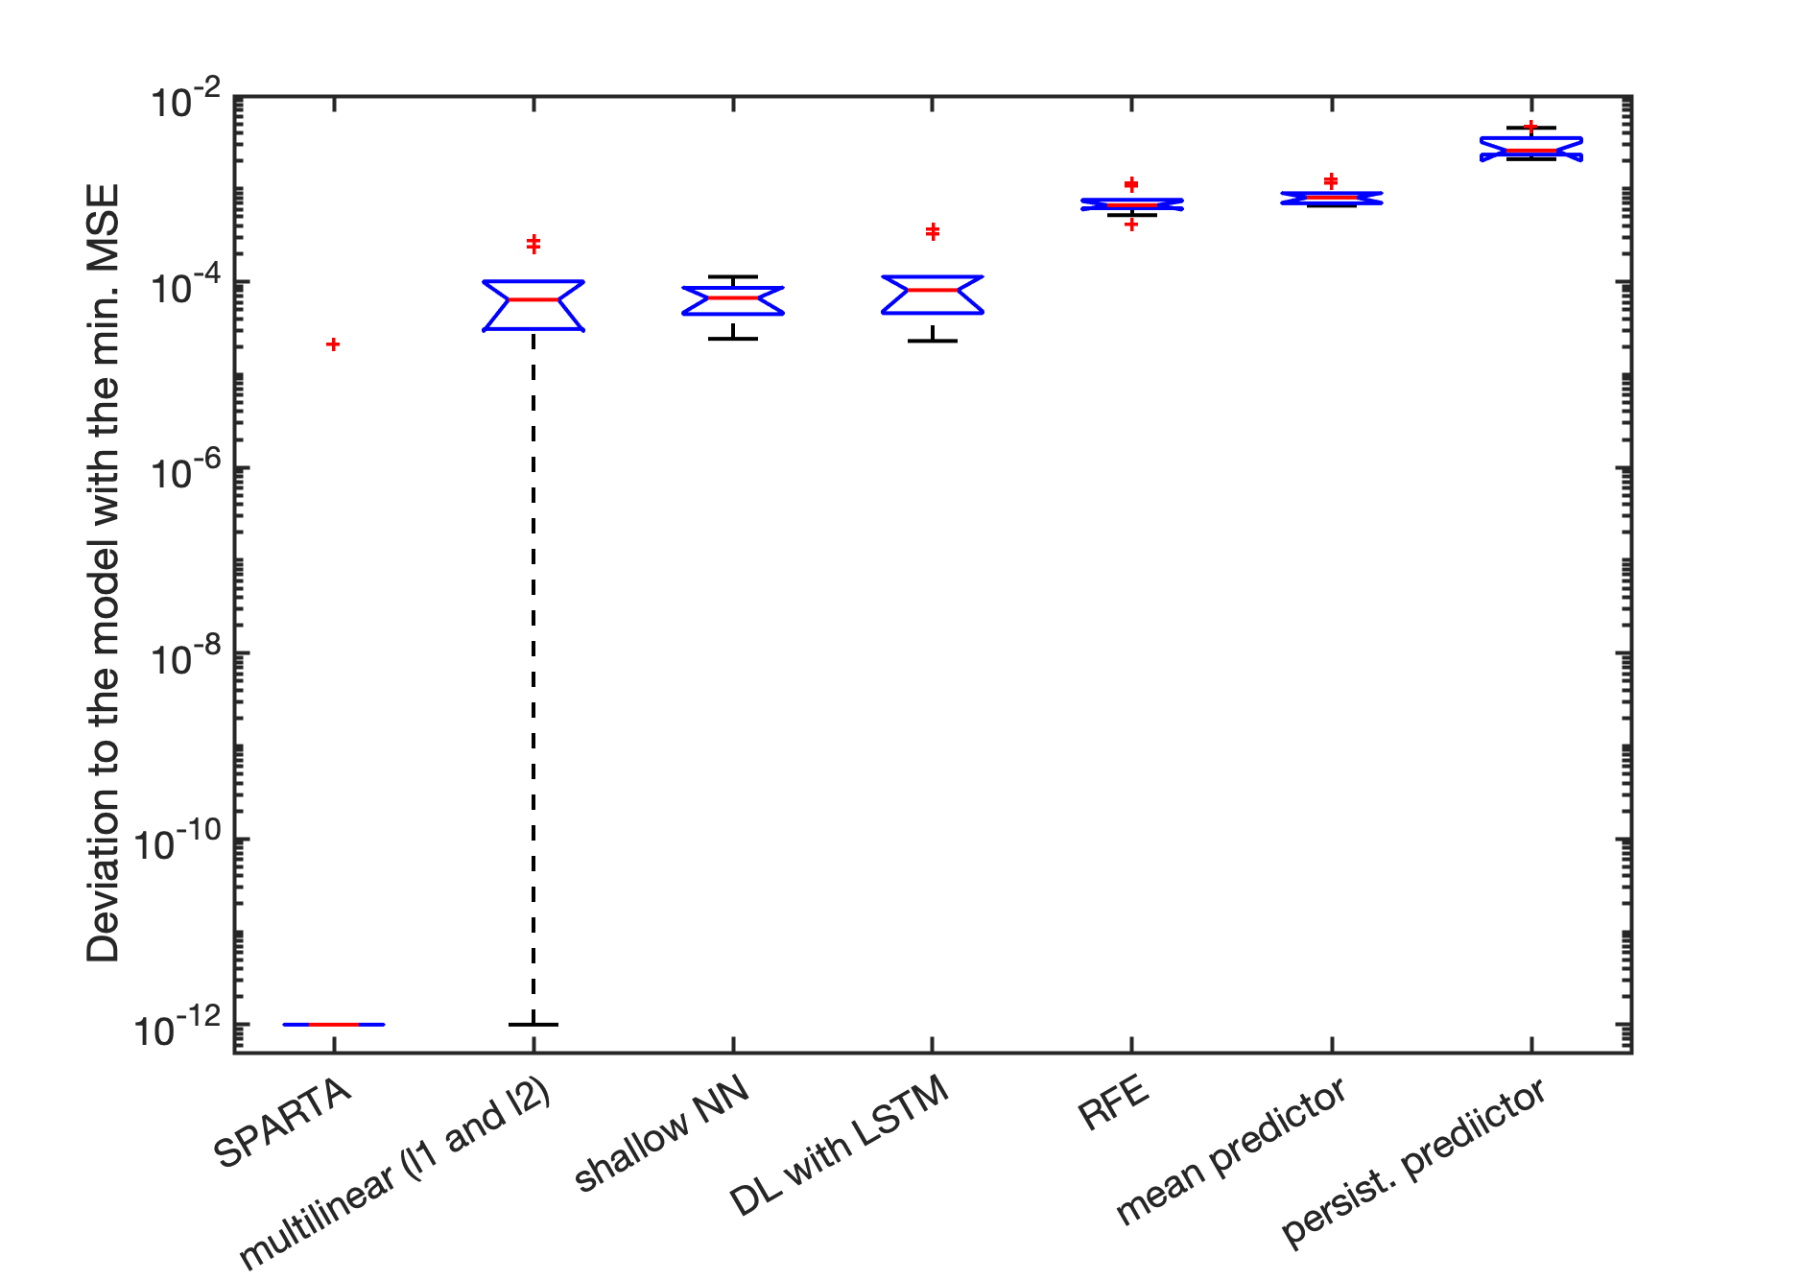
Application example 1: predicting dayly change of price (S_{t+1}-S_{t}) and its dependence
from previous days price changes (open, low, high, close) AND news proportion sentiments (positive, neutral, negative)
for dayly Apple Stock between 2006 and 2016. Data from Kaggle.com.

Slide 7
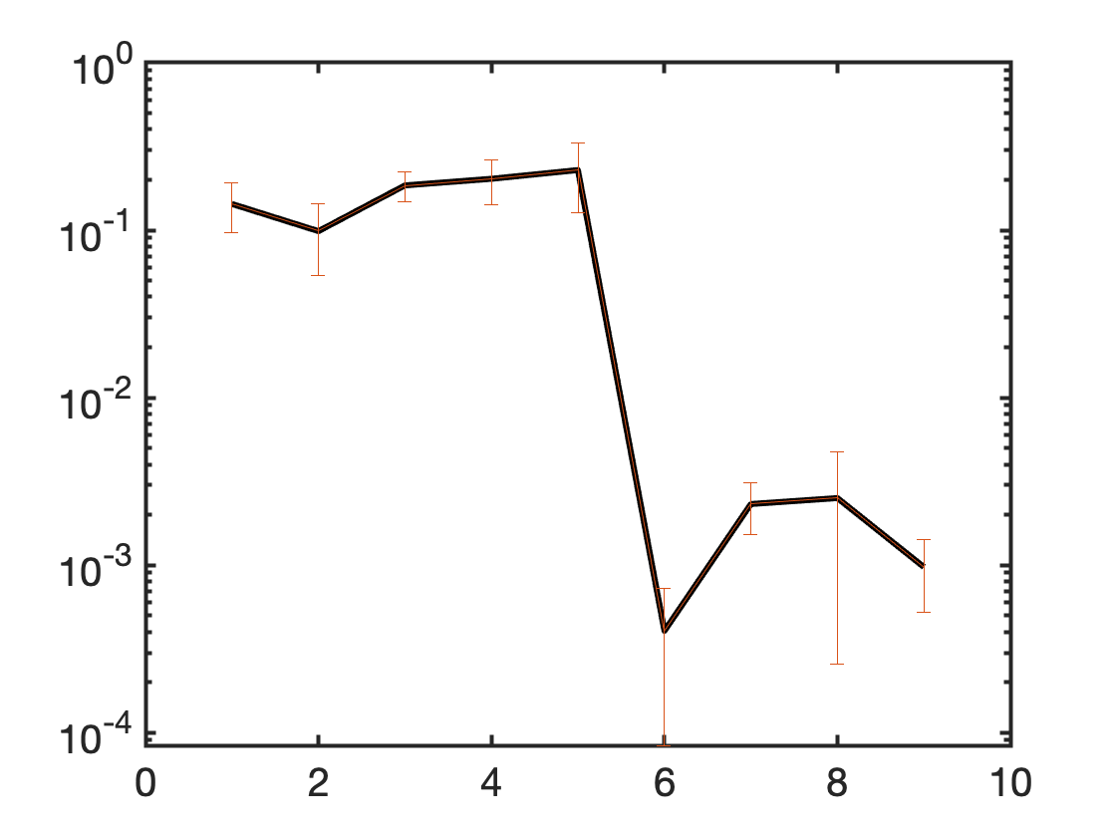
Application example 1: predicting dayly change of price (S_{t+1}-S_{t}) and its dependence
from previous days price changes (open, low, high, close) AND news proportion sentiments (positive, neutral, negative)
for dayly Apple Stock between 2006 and 2016. Data from Kaggle.com.
Feature weight W_{i} from SPARTA

Slide 8
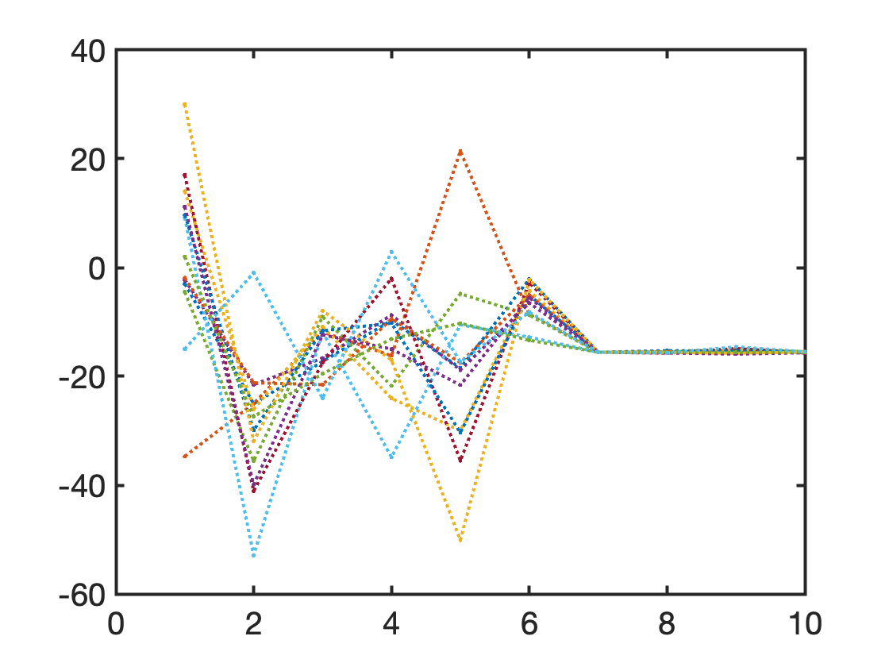
Application example 1: predicting dayly change of price (S_{t+1}-S_{t}) and its dependence
from previous days price changes (open, low, high, close) AND news proportion sentiments (positive, neutral, negative)
for dayly Apple Stock between 2006 and 2016. Data from Kaggle.com.
Coefficients W_{i}𝜆_{k,i} from K piecewise linear
regrssions in SPARTA
intercept

Slide 9
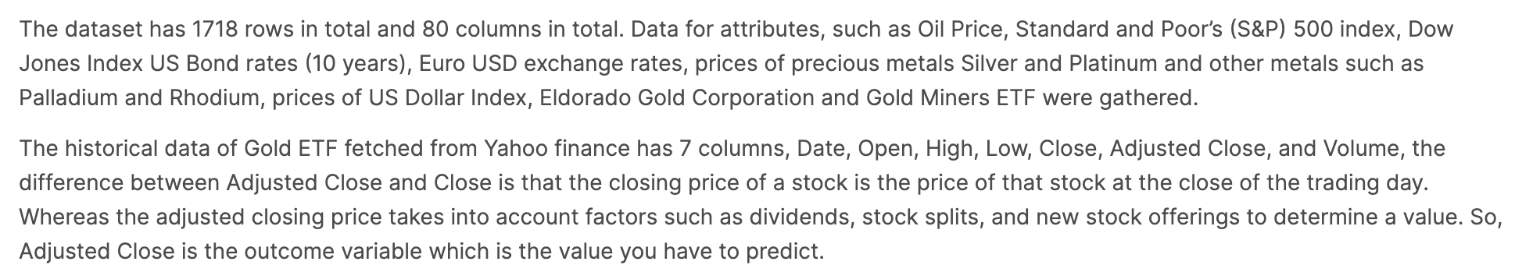
Application example 2: predicting interday absolut change of price of S&P |S_{t}^{close} –S_{t}^{open}|. Data from Kaggle.com.
https://www.kaggle.com/datasets/sid321axn/gold-price-prediction-dataset

Slide 10
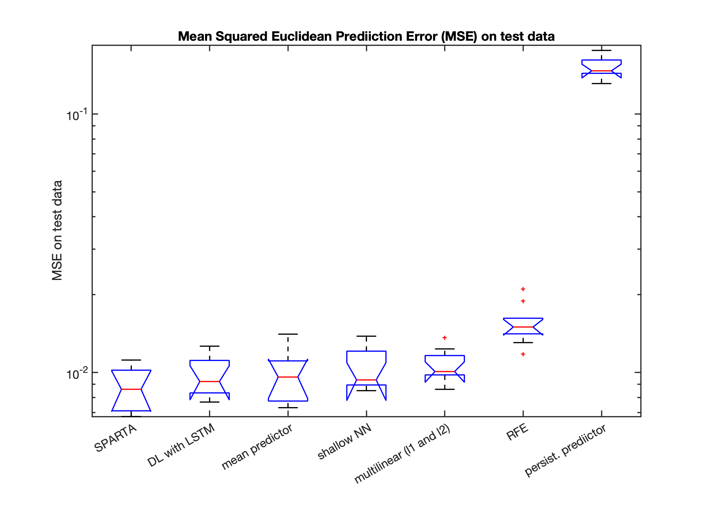
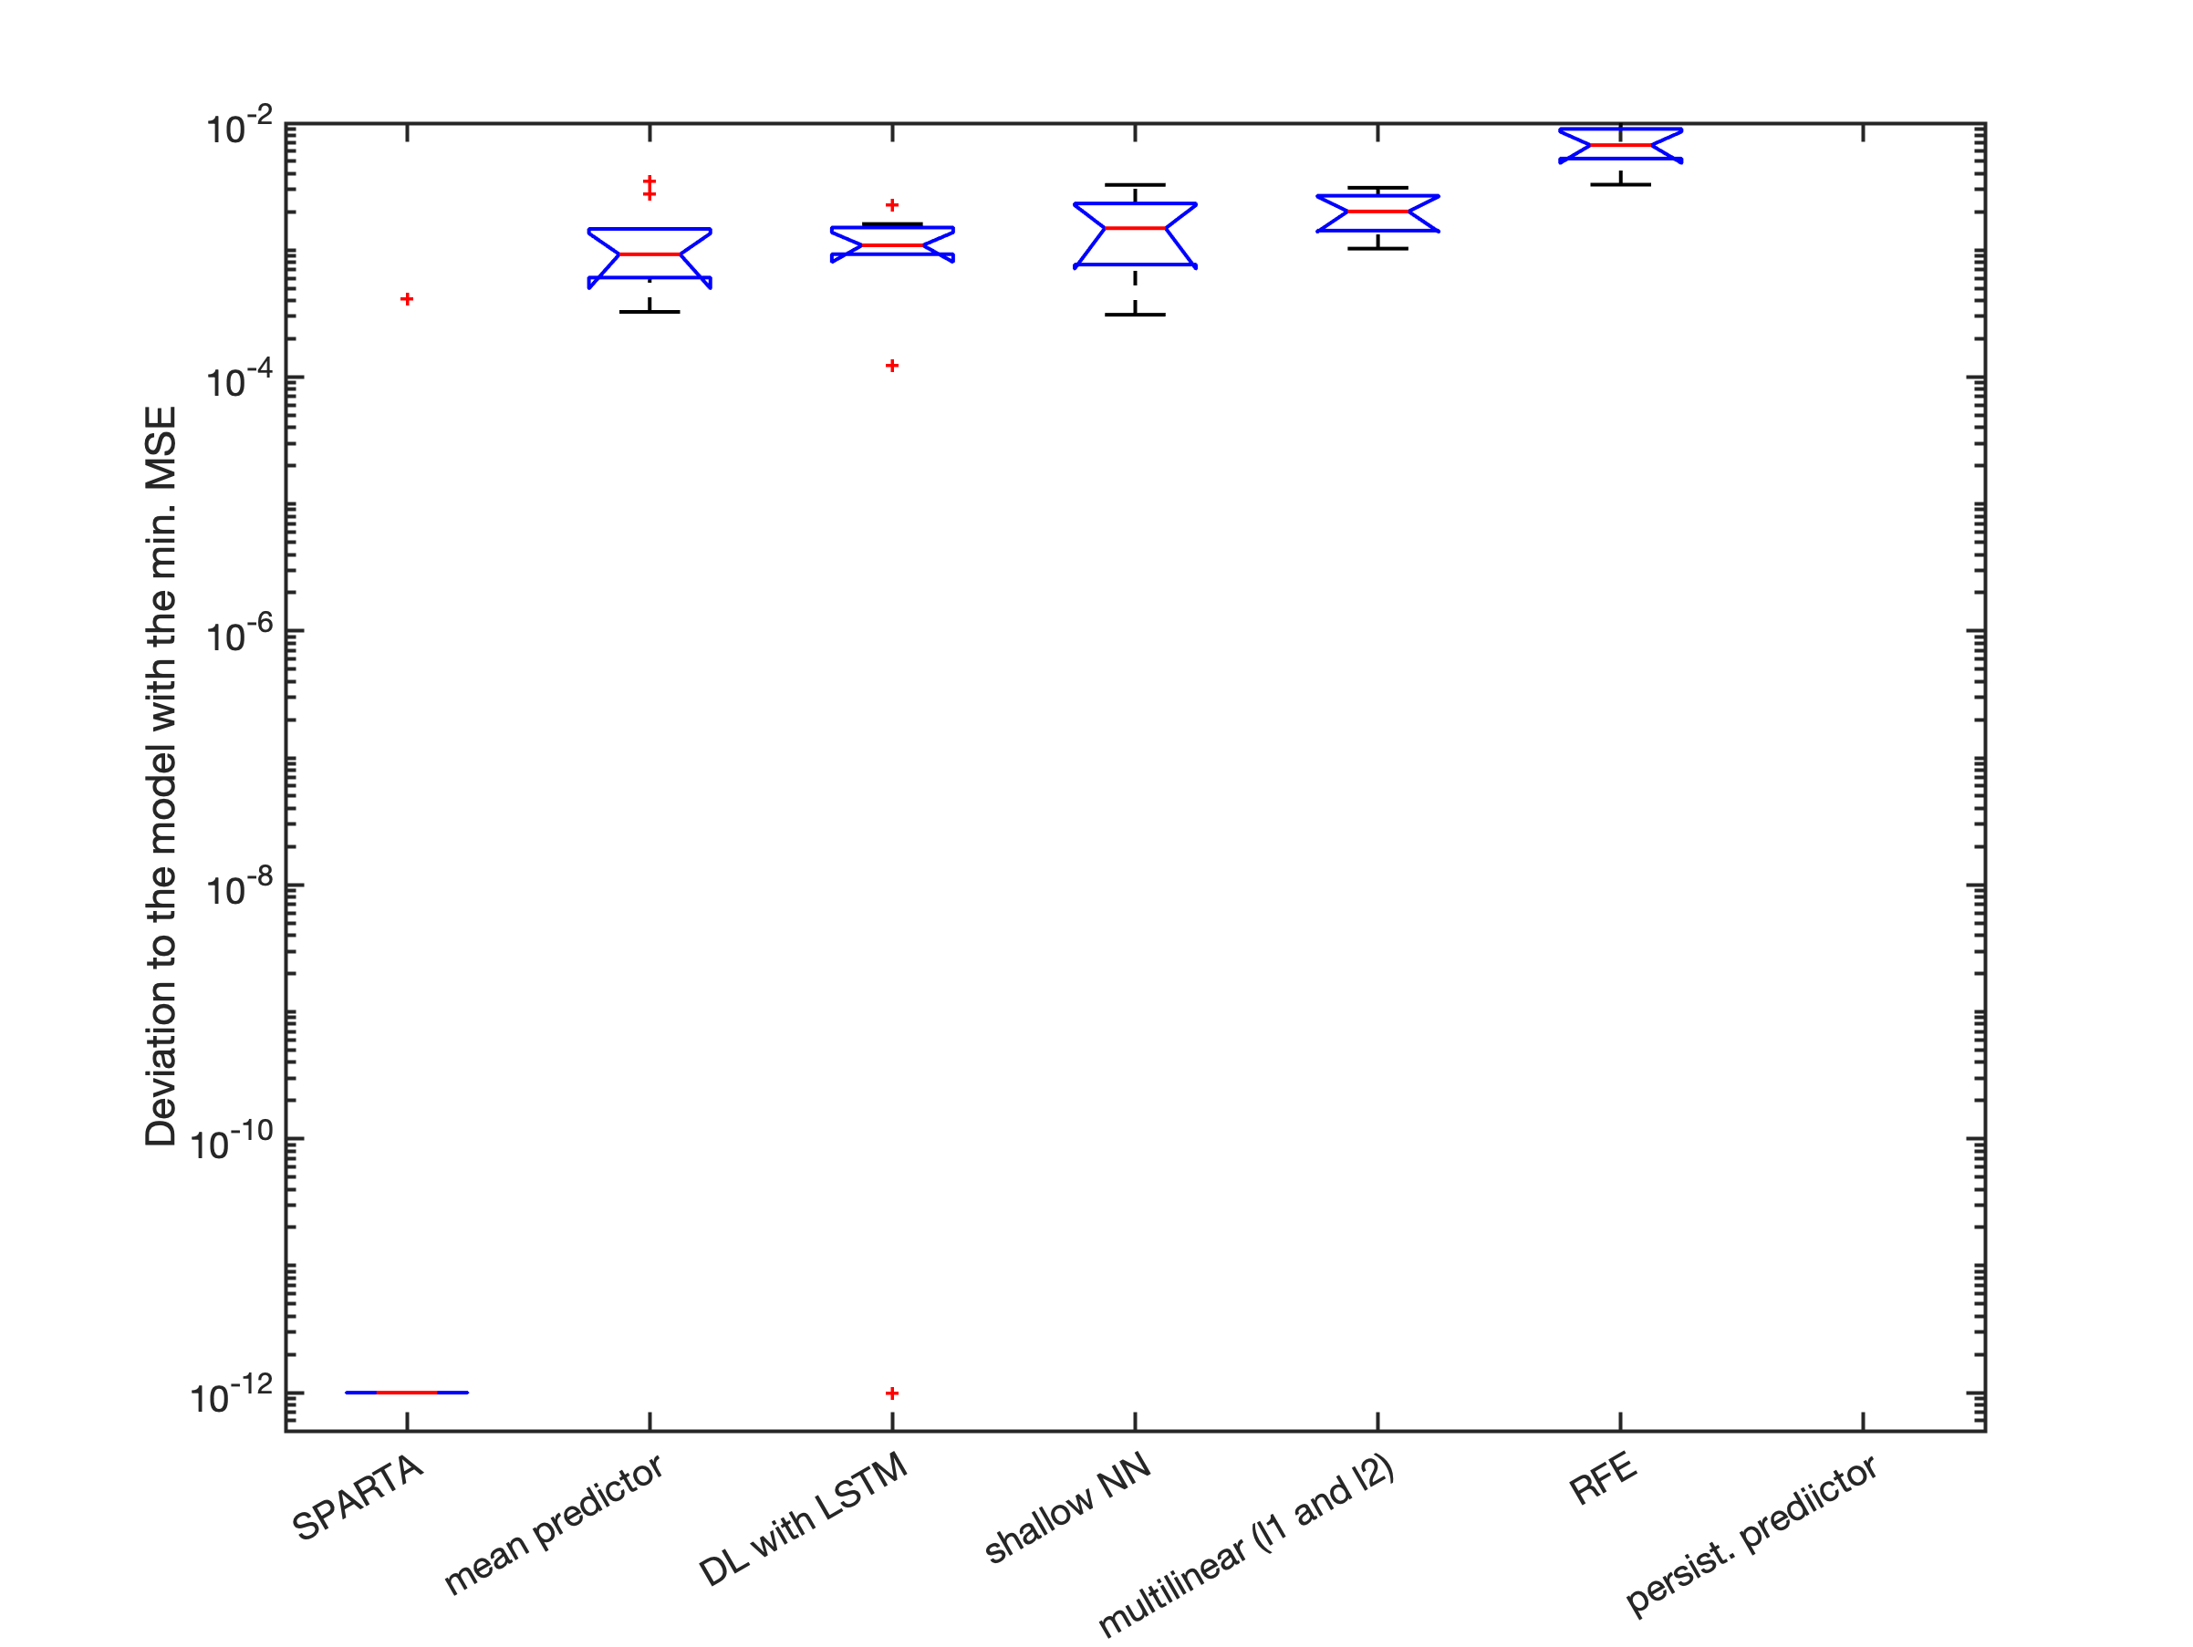
Application example 2: predicting interday absolut change of price of S&P |S_{t}^{close} –S_{t}^{open}|. Data from Kaggle.com.

Slide 11
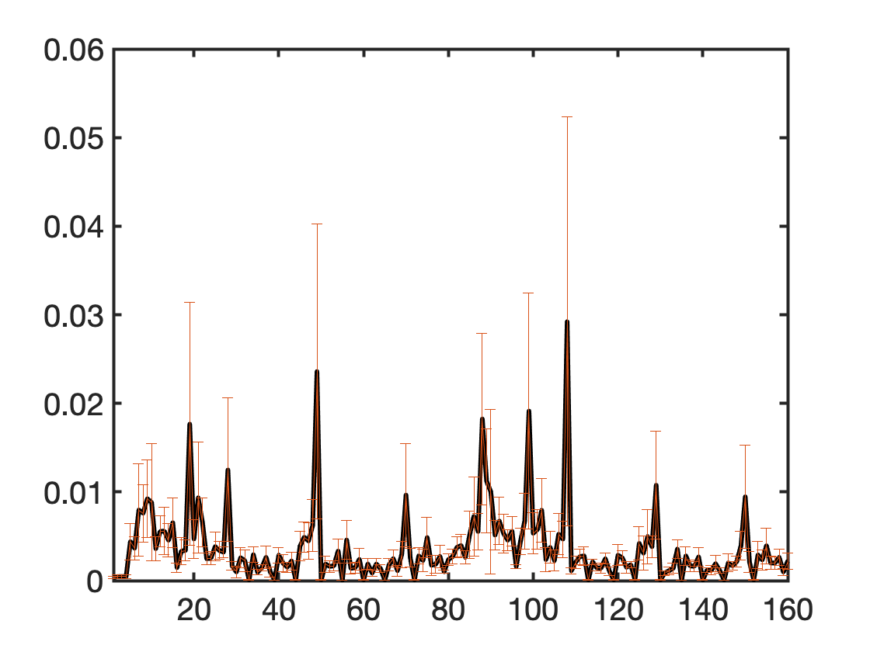
Application example 2: predicting interday absolut change of price of S&P |S_{t}^{close} –S_{t}^{open}|. Data from Kaggle.com.
t-2 days
t-1 day
Feature weight W_{i} from SPARTA

Slide 12
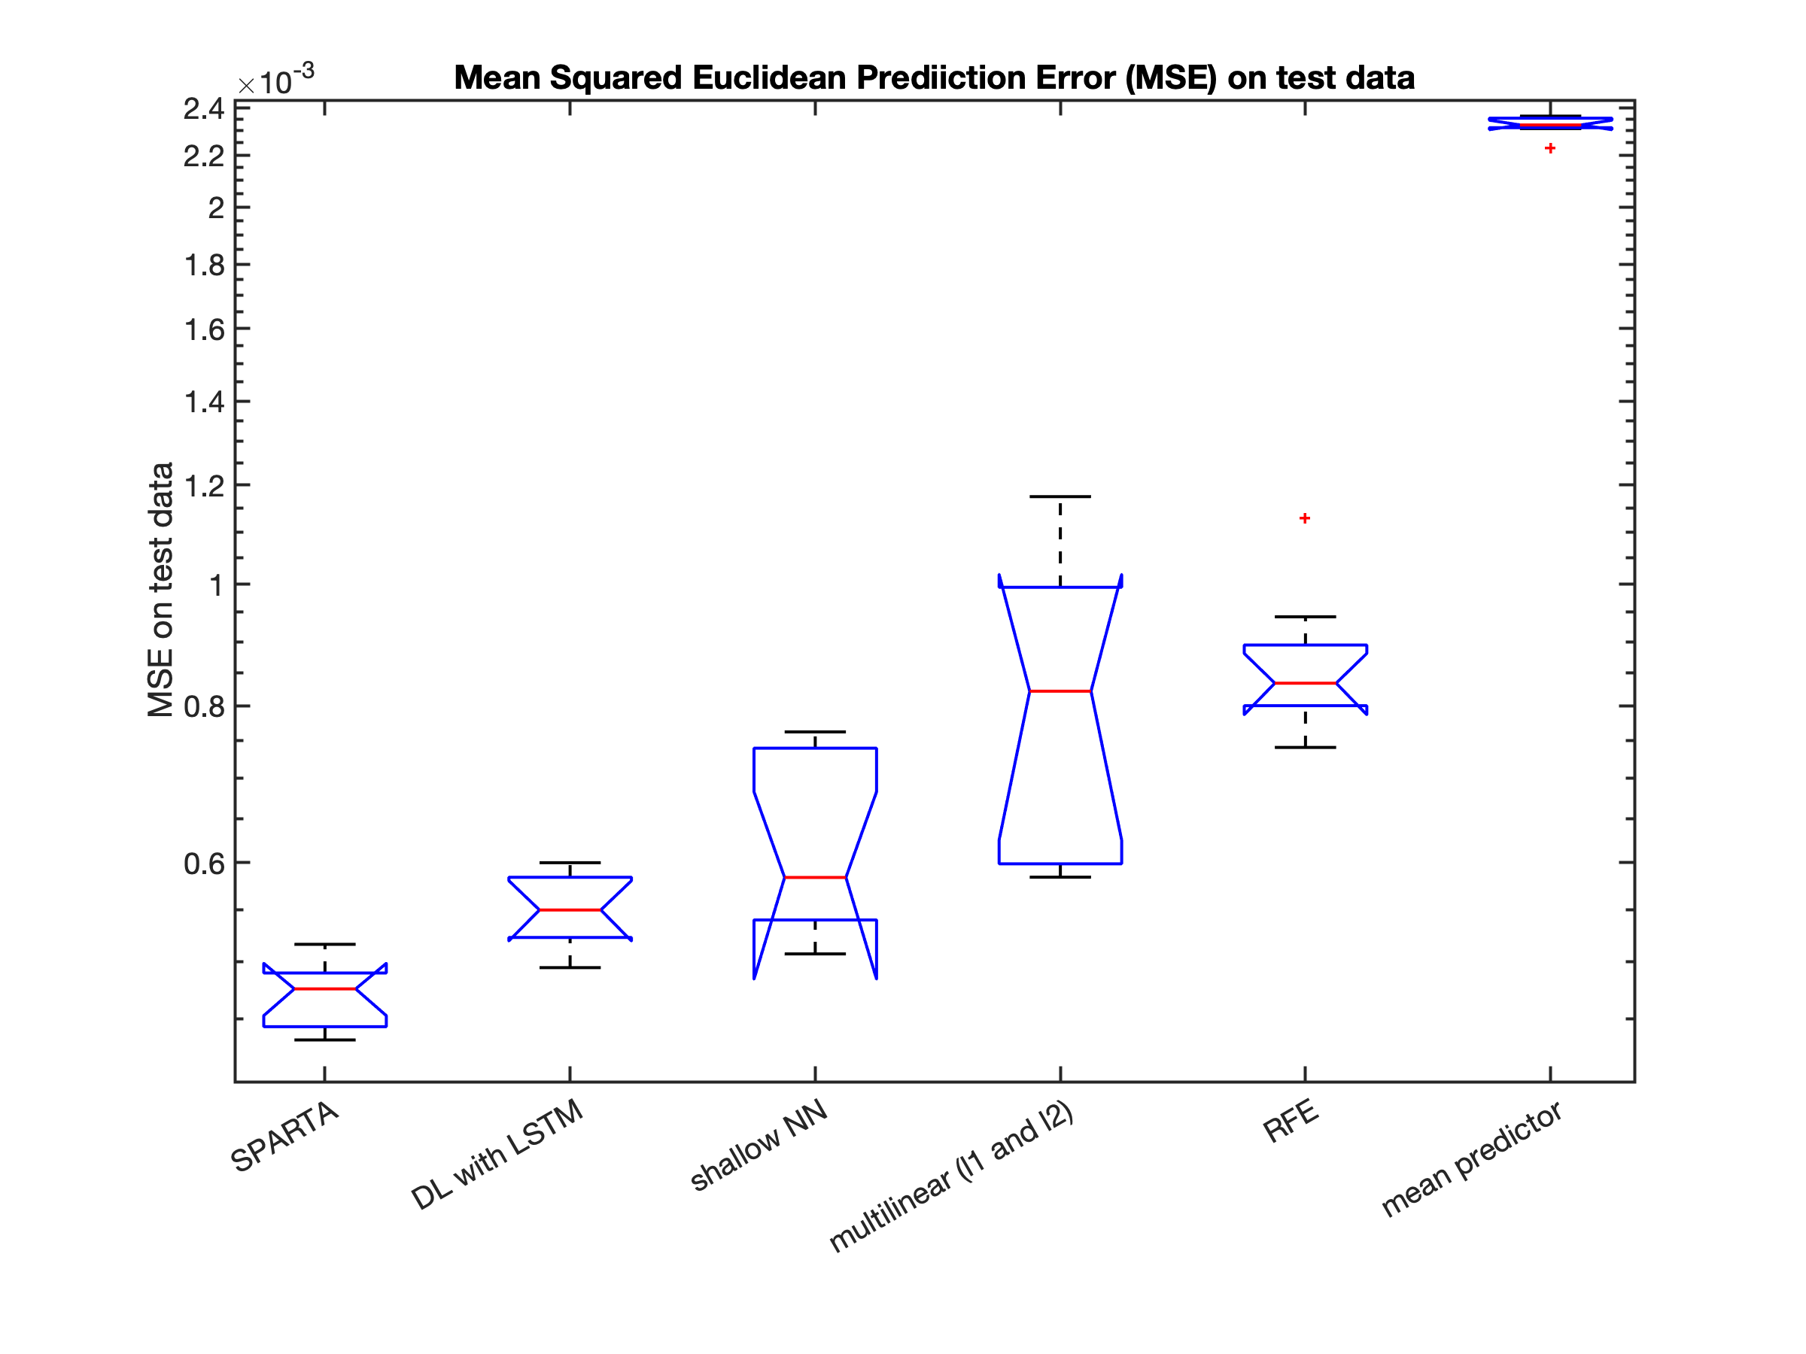
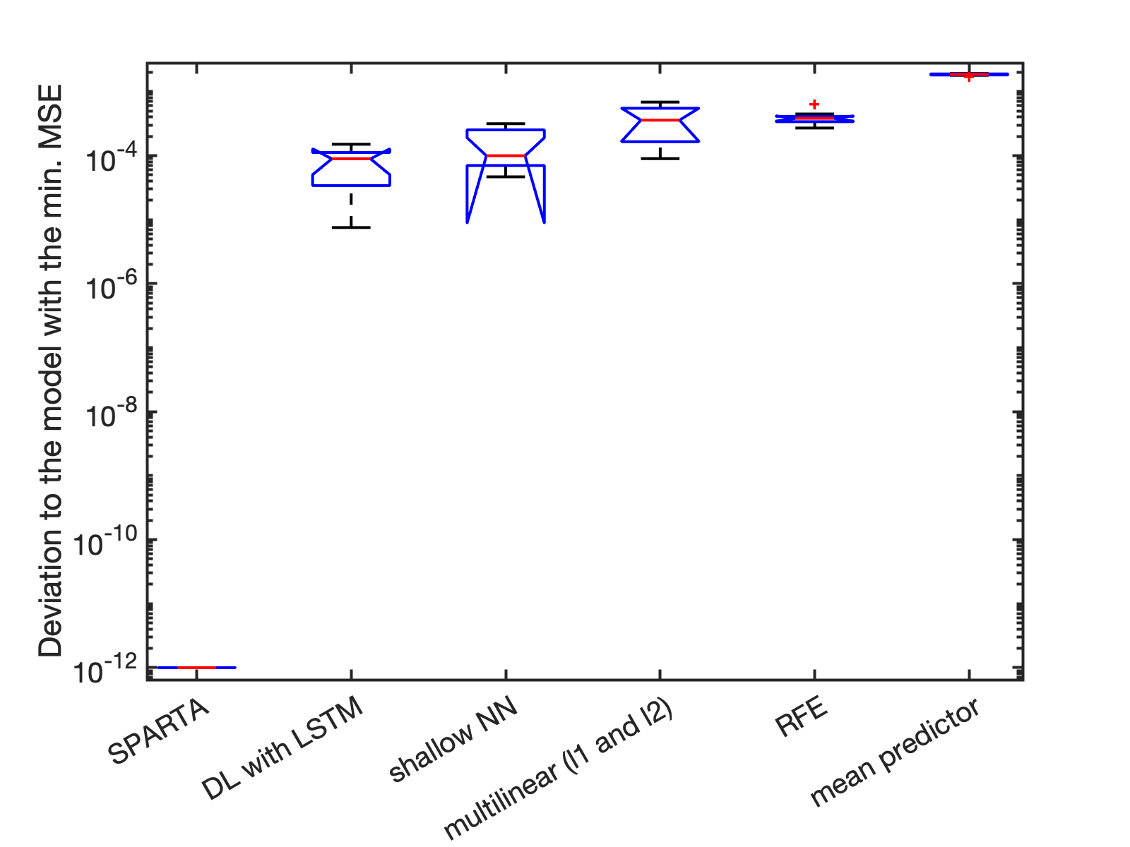
Application example 3: predicting house prices. Data from 23'000 houses in King County in US
between 2014 and 2015from Kaggle.com.
https://www.kaggle.com/datasets/harlfoxem/housesalesprediction

Slide 13
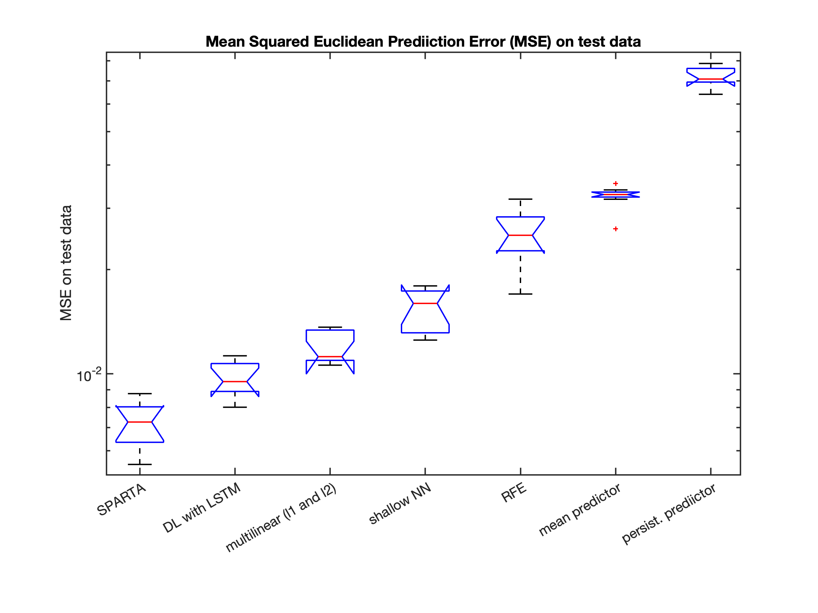
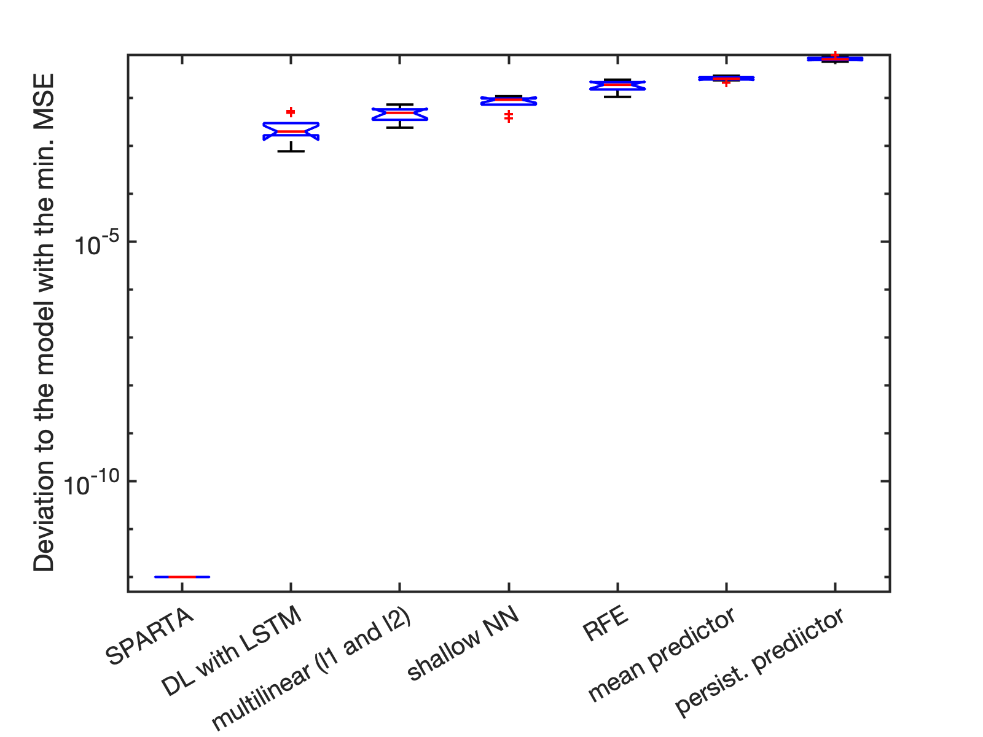
Application example 4: predicting El Nino Southern Oscillation (ENSO) with a 12 months of lead time.
ENSO is one of the dominant climate indicators and was shown to have a major impact on commodity prices.
Data from Kitsios et- al. " Forecasting commodity returns by exploiting climate model forecasts of the El Niño Southern Oscillation" Environmental Data Science (2022), 1: e7, 1–16doi:10.1017/eds.2022.6

